Slide 1
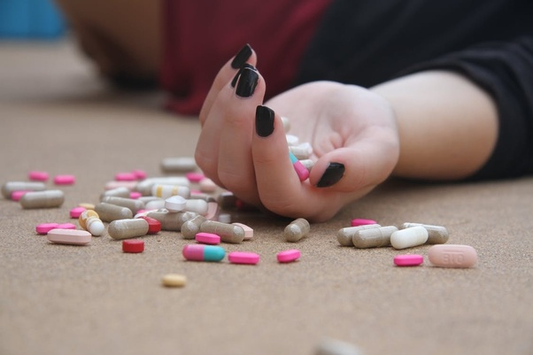
Drugs used in the treatment of affective disorders
Dr. A. U. Medagedara
Probationary lecturer
Department of Pharmacology

Slide 2
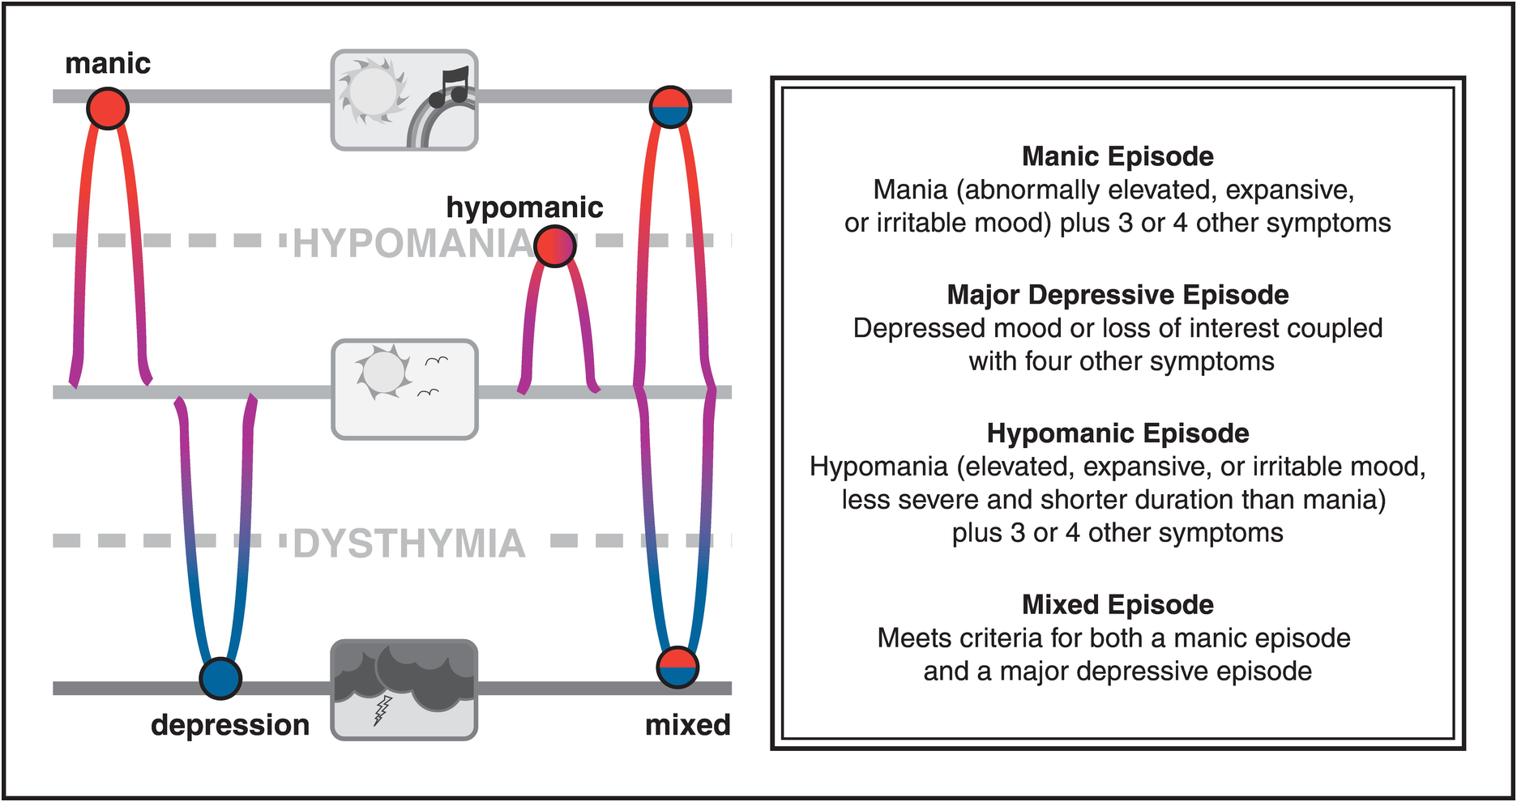

Slide 3
Depression and anti depressanats
Monoamine hypothesis
  Depression is due to a deficiency of monoamine neurotransmitters (Dopamine, Noradrenaline and serotonin)
  Drugs used in depression elevate the levels of these neurotransmitters

Slide 4
Antidepressanats
Selective serotonin reuptake inhibitors(SSRI)
SNRI
Tricyclic antidepressants
Monoamine oxidase inhibitors(MAOI)

Slide 5
SSRIs
Selective serotonin reuptake inhibitors
Increase serotonin level
Less side effects compared to Tricyclics and MAO inhibitors specially anticholinergic effects
Doesn’t offer greater efficacy than TCA in depression

Slide 6
SSRIs-Indications
Depression
Anxiety disorders (Generalized anxiety disorder, panic attacks, social anxiety disorder, post traumatic stress disorder)
Obsessive compulsive disorders
Bulimia nervosa (Fluoxetine)

Slide 7
SSRIs- Side effects
Gastrointestinal side effects are common
Hypersensitivity
SIADH & hyponatraemia
Extra pyramidal side effects
Hyperprolactinaemia
Sexual dysfunction
Hypothyroidism
Bleeding disorders
Increased risk of suicidality
Safe in cardiac diseases and diabetes mellitus

Slide 8
Fluoxetine
Unwanted activation in patients with agitation, insomnia, anxiety Insomnia and agitation is more common Drug of choice in DM + depression
Oral 1/day Long t/_{1/2}→2-3/365 Active metabolite t/_{1/2} →2/52 → Reduces withdrawal reactions Increase time to clear drug and active metabolite after discontinuing drug and starting another like MAOI

Slide 9
Sertraline
Anxiety symptoms need close dose titration or else over activation occurs in patients with panic disorders Higher rate of diarrhoea Treatment for premature ejaculation

Slide 10
Paroxetine
More calming and sedating Higher anti muscarinic side effects Higher weight gain, sedation and EPS than other SSRIs NO synthetase inhibition → Sexual dysfunction in males
Withdrawal reactions upon sudden discontinuation Available in controlled release formulation→ Less S/Es and discontinuation reactions

Slide 11
Fluoxamine
Increase remission in OCD and Social Anxiety disorder
IR→ t/_{1/2} = 2/day Controlled release 1/day

Slide 12
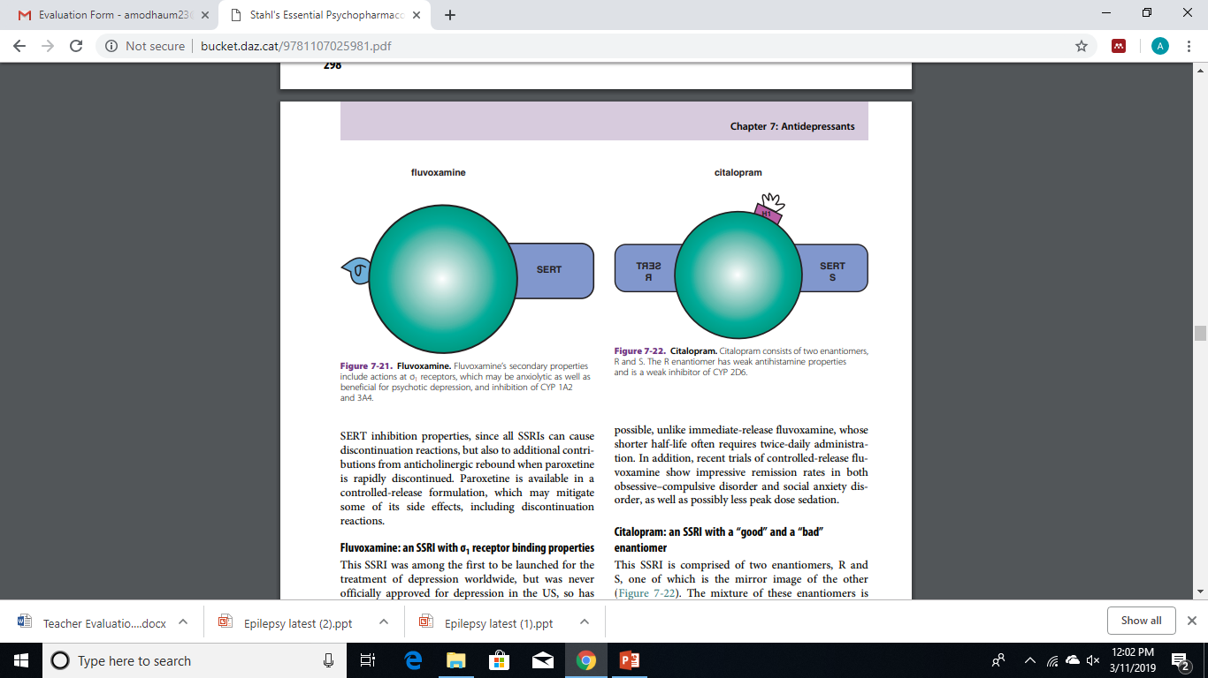
Citalopram
Comprises of both SERT-R & S enantiomers QTc prolongation Mild- antihistamine properties
Inconsistent therapeutic action at low doses So need to increase dose But increasing dose is limited due to potential for QTc prolongation

Slide 13
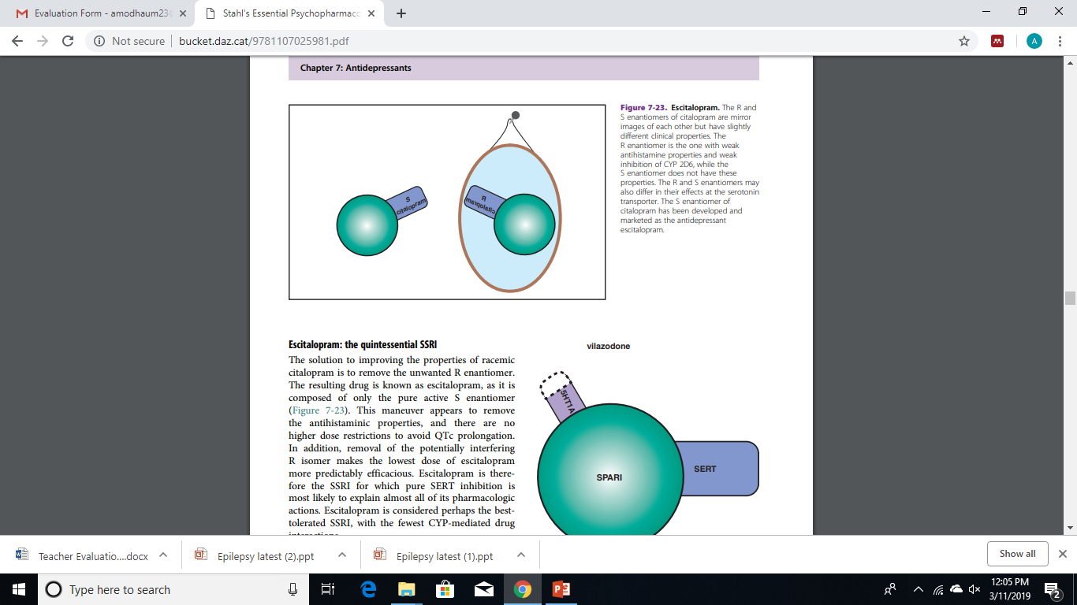
Escitalopram
Best tolerated SSRI R enantiomer is removed No antihistamine properties QTc prolongation occur only in overdose
No high dose restrictions Make even lowest dose more predictable and efficacious

Slide 14
SNRIs
Serotonin and norepinephrine reuptake inhibitors
Increases serotonin, norepinephrine(NE) and dopamine(DA).
There’s not much of DA transporters in the prefrontal cortex so DA too is mainly up taken by NE transporters
Ex: Venlafaxine, Desvenlafaxine, Duloxetine, Milnaciparin

Slide 15
SNRIs- Side effects
SIADH & hyponatraemia
Hyperprolactinaemia
Sexual dysfunction
Bleeding disorders
Extra pyramidal side effects
Not safe in cardiac diseases
- Cause Hypertension, and even arrhythmias though less common
- Overdose of Venlafaxine- QT interval prolongation

Slide 16
Type of antidepressant | Mechanism of action | Examples
SPARI | Serotonin partial agonist and reuptake inhibitor | Vilazodone
NDRI | Norepinephrine and dopamine reuptake inhibitor | Bupropion
NERI | Norepinephrine reuptake inhibitor | Atomoxetine Reboxetine
Alfa 2 antagonists | Increase presynaptic norepinephrine & post synaptic serotonin | Mirtazapine
5HT3 antagonists | Increase all monoamines, histamine & acetyl choline | Vortioxetine
SARI | 5HT 2A antagonism resulting in increased dopamine & serotonin reuptake inhibitor | Trazodone
Agomelatine | Stimulates melatonin receptors and resynchronizes the circadian rhythm
Mirtazapine – Safe choice in cardiac diseases

Slide 17
Tricyclic antidepressants
Inhibit both serotonin and norepinephrine transporters and increase levels of dopamine, serotonin and noradrenaline.
Has additional antihistamine, anti alfa 1 receptor and antimuscarinic effects
Take a week or more to show their antidepressant effect
Best is to give as once a day oral dose at night
Treatment is usually started with a small dose at night and is increased at 2 weekly intervals.
Ex:Clomipramine, Imipramine, Amitriptyline, Doxepin

Slide 18
Indications for use
Depression
Anxiety states/PTSD
Nocturnal enuresis in children
Irritable bowel syndrome
Eating disorders
Neuralgias (Neuropathic lower back aches)
Some forms of headache-migraine
Premenstrual symptoms/Vasomotor symptoms of menopause

Slide 19
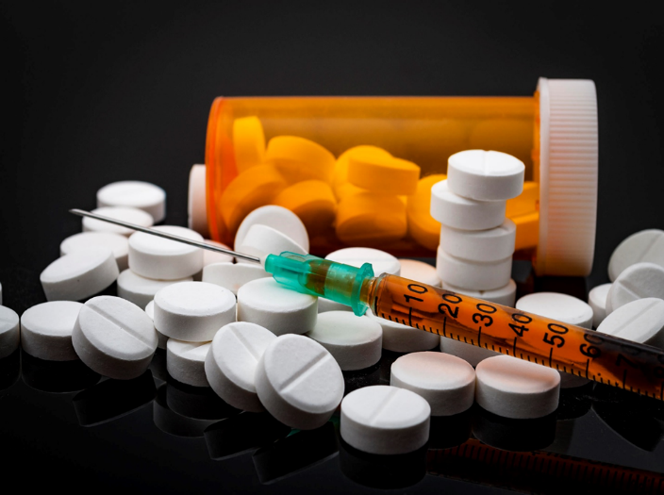
Adverse effects
Anti histamine side effects
-Sedation, Weight gain
Anti muscarinic side effects
-Dry mouth, blurring of vision, constipation, difficulty in micturition, drowsiness and cognitive impairment
Alfa 1 block side effects
-Hypotension, dizziness and drowsiness
Over dose - Sodium channel inhibition
-CVS –Tachycardia, arrhythmias
(QRS & QT prolongation)
-CNS –Seizures, coma
Confusion in the elderly
Therapeutic drugs 2

Slide 20
Choice of tricyclic
Amitriptyline is sedating and preferred in patients with insomnia.
Imipramine is less sedating

Slide 21
Monoamine oxidase inhibitors
MAO is one of the two main enzymes involved in the catabolism of monoamines.
Used in endogenous depression not responding to other medication
Can be given in panic disorders and social phobia
MAO-B inhibitors Selegiline & Rasagiline are used in Parkinsonism
Ex: Irreversible inhibitors- Phenelzine, Tranylcypromine, Isocarboxacid
Weak, reversible inhibitors-Moclobemide

Slide 22
MAOIs drug interactions
Tyramine (Tyramine releases norepinephrine) containing food like aged cheese, dried, aged, spoiled meat or fish; unpasteurized beer, marmite, soy products/tofu and banana peel produce a hypertensive reaction “cheese reaction”
Local anesthetics that contain epinephrine and sympathomimetic decongestants should be used with caution

Slide 23
MAOIs drug interactions
Avoid MAOIs with serotonergic agents → Increased risk of developing serotonin syndrome
Has to wait for 5 half lives after discontinuing a serotonergic drug before starting a MAOI
Start of serotonergic agents should be delayed by 2 weeks if patient was on a MAOI previously
TCAs can be combined with MAOIs (Exception- Clomipramine-potent serotonin reuptake inhibitor) with caution in severely treatment resistant patients

Slide 24
Serotonin syndrome
Seratonin production by making precursors available
“L-tryptophan”
Release of stored serotonin
“amphetamine/cocaine”
Stimulation of serotonin receptors
“buspirone”
Inhibition of serotonin metabolism
“MAOIs”
Inhibition of serotonin reuptake
“SSRIs/SNRIs/TCAs”
Unknown mechanism
“Lithium”
With initiation of above drugs/dose increase/over dosage/drug combination (not usually & therapeutic dose)

Slide 25
Signs and symptoms
Serotonin syndrome-1%
1) Fever >38°c
2)Tremor, shivering, myoclonus, hyper reflexia (LL>UL),ataxia, seizures/rarely-rigidity
3)Autonomic instability-sweating, diarrhoea, PR↑, labile BP
4)Mental state change-confusion,agitation(restlessness),coma

Slide 26
Diagnostic criteria
Toxicology-Gold standard
Dx of exclusion
Hunter’s criteria
Being on a serotonergic agents & 1/5
1)Spontaneous clonus
2)Inducible clonus (agitation or diaphoresis)
3)Ocular clonus (agitation or diaphoresis)
4)Tremor + Hyperreflexia
5)Hypertonia + Temp>38°c+ocular clonus/Inducible clonus

Slide 27
Differential diagnosis
1)NMXN
2)Malignant hyperthermia
3)Encephalitis/meningitis/sepsis
4)Metabolic disturbances
5)Cocaine withdrawal/over dose

Slide 28
Investigations
FBC
LFT
RFT
FBS
Ca²⁺/Mg²⁺/Po4³⁻/anion gap/
CPK
Drug toxicity screening
CXR
ECG- Arrhythmias-QT,QRS prolongation, conduction problems
-

Slide 29
Management
General measures | Specific measures
Fever-Anti pyretics, cooling Rehydration In order to prevent Rhabdomyolysis- Rehydration/IV NaHco₃-target alkaline urine Monitor IP/OP & maintain ↑ out put | 1.Agitation/seizure risk/myoclonus.(rigidity) → Benzodiazepam-IV lorazepam 2mg slow infusion once in every 30 mins) 2.Serotonin receptor antagonist → Cyproheptadine-4-8mg every 2-4h(max 0.5mg/kg/day) 3. Only if BP is significantly & persistently high →Nitroglycerin IV 2mg/kg/min)

Slide 30
Prognosis
Most resolve in 24-36 hrs
If as asymptomatic following SSRI overdose for hours. No need of treatment
(Death rate if severe 2-12%)

Slide 31
Compare & contrast
 | NMS | Serotonin Xn
Cause | Antipsychotics NL dose Idiosyncratic | Serotonergic Rx Over dose/drug combination
Onset | Slow(days-week) | Rapid
Progression | Slow(24-72 hrs.) | Rapid
Muscle rigidity | Severe(lead pipe) | Less severe
Activity | Bradykinesia | Hyperkinesia
Therapeutic drugs 2
Therapeutic drugs 2

Slide 32
Drugs used in manic depressive psychoses/ Bipolar affective disorder- Mood stabilizers
Lithium
Sodium valproate
Carbamazepine
Lamotrigine
Topiramate
Levetiracetam
Gabapentine-Binds with alfa 2 delta ligands of calcium channels and inhibits them. Blockade of calcium channels prevents release of Glutamate
Pregablin - Similar to GABA

Slide 33
Drugs used in manic depressive psychoses/ Bipolar affective disorder- Others
Benzodiazepam
-Antiepileptic
-Anxiolytic
-Hypnotic (In insomnia)
-Alcohol withdrawal syndrome
-Muscle relaxant
-Adjunctive agent to mood stabilizers

Slide 34
Lithium
Effective in the prophylaxis of manic depressive psychoses, treatment of acute mania, bipolar depression and unipolar depression as an augmenting agent to antidepressants
Reduce suicidal risk
Inhibits down stream signal transduction cascade
Well absorbed from the gut and eliminated unchanged in urine
Has a narrow therapeutic index.
Needs the monitoring of plasma concentrations

Slide 35
Side effects
Metallic taste in mouth
Renal toxicity/Interstitial nephritis- eGFR
Nephrogenic diabetes insipidus(reversible)- Polyuria, polydipsia
Hypothyroidism
Hyperparathyroidism
Fine tremors
Weight gain
Hair loss
Ankle oedema
Acne & psoriasis
WBC
Serotonin Xn

Slide 36
Monitoring
Lithium level
-t/2 = 7-20 hrs
-7 days after initiating the treatment or changing the dose Li level should be monitored(12 hours after the last dose)
-6 monthly thereafter
-TSH
-eGFR Before initiation of treatment & 6/12 ly afterwards
-BMI

Slide 37

Lithium toxicity
Discussed already inDrugs 2
Therapeutic drugs 2

Slide 38
Sodium Valproate
Used in the acute manic phase of BAD
prophylaxis for mania (prevent recurrence)
Some efficacy for depressive phase of BAD
Used in patients who cannot tolerate lithium or who do not respond to lithium. Can be combined with lithium or other mood stabilizers

Slide 39
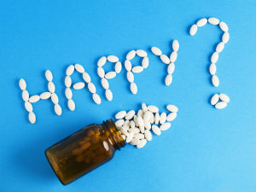
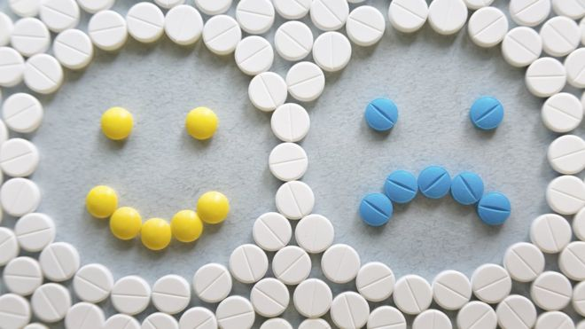
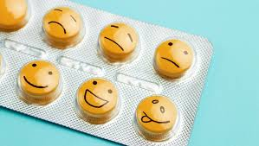
Thank you.

